Slide 1
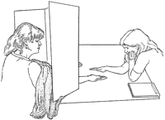
Solution to HW4

Slide 2
Background to Part 1
In 1998, Emily Rosa et al. “investigated whether TT [Therapeutic Touch] practitioners can actually perceive a ‘human energy field.’ … [P]ractitioners … were tested under blinded conditions to determine whether they could correctly identify which of their hands was closest to the investigator’s hand. Placement of the investigator’s hand was determined by flipping a coin.”

Slide 3
1. What is the null hypothesis here?
(i) The chance of guessing correctly > 50%
(ii) TT practitioners can not reliably detect a human energy field
(iii) The chance of guessing correctly = 50%

Slide 4
2. Smallest number of correct guesses that would provide “stat. significant” (p < 0.050 evidence of HEF:
p < 0.05 → Z = 1.645
n = 280, p = 0.5 → EV = np = 140, SE = sqrt[ np(1–p) ] = 8.367
→ need more than ~ 140 + 1.645*(8.367) + 0.5 ~ more than 154.3 or so
[Actual number: k=155, since =1-BINOMDIST(154,280,0.5,TRUE) = 0.0414]

Slide 5
3. P(123 or more correct) = 0.982
In Excel, =1-BINOMDIST(122,280,0.5,TRUE)
Normal approx.: EV=140, SE=8.367, P(123 or more) = P(Z > –2.092)
4. If P(correct guess) = 0.90, there would be 99% chance that # correct > 240
Normal approx. if p=0.9: EV=252, SE=5.02, 1st percentile → Z = –2.326 → number correct = 252 – 2.326*5.02 = 240.3
[ In Excel, =BINOM.INV(280,0.9,0.01) ]

Slide 6
5. Most reasonable conclusion to draw?
There is statistically significant evidence (p = 2.4%) that a human energy field exists.
The results show statistically significant evidence in favor of a human energy field (p = 2.4%), but it is likely that the stat. significant results were due to luck.
The results provide stat. significant evidence that the probability of guessing correctly is exactly 50.0%.
The results indicate that the probability of guessing correctly could be 50.0% or even lower.
The results are not statistically significant, which means there is chance of guessing correctly must be 50.0% or higher.

Slide 7
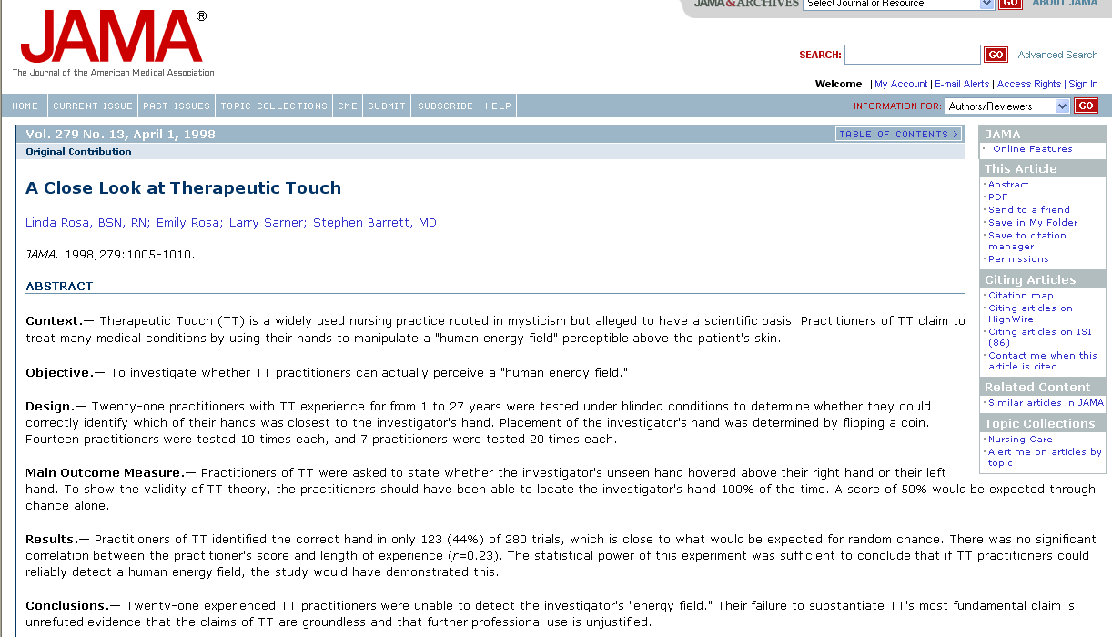
Remark 1
“Practitioners of TT identified the correct hand in only 123 (44%) of 280 trials, which is close to what would be expected for random chance.”
“Conclusion -- Twenty-one experienced TT practitioners were unable to detect the investigator’s “energy field.” Their failure to substantiate TT’s most fundamental claim is unrefuted evidence that the claims of TT are groundless and that further professional use is unjustified.”

Slide 8
Remark 2
In fact, only 123 correct of 280 is stat. significantly worse than pure guessing
One explanation: bad luck [equiv. to about six heads in a row on a fair coin]
Another explanation: Rosa transmitted negative HEF, causing false readings
Student comment: “[with you], it’s hard to tell where the math ends and the sarcasm begins.”
This is similar to an actual explanation given (“failure of Rosa to transmit her HEF properly”)

Slide 9
Questions on part 1?

Slide 10
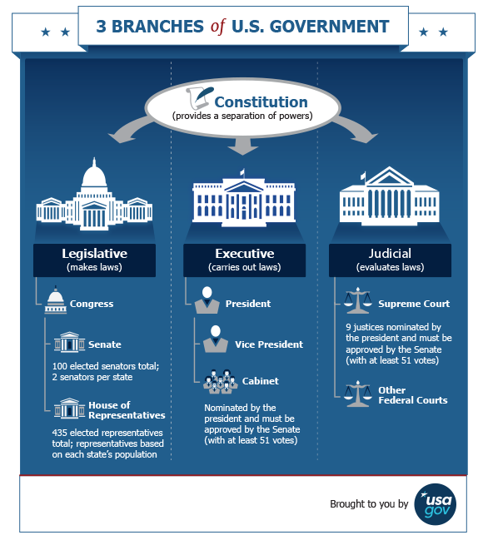
233 out of 705 could not name a single branch of the U.S. government

Slide 11
233 out of 705 could not name a single branch of the U.S. government
Q6. 95% conf. interval for % of all adults:
Point estimate = 233/705 = 33.05%
Est. SE = sqrt[ p(1–p)/n ] = 1.772%
95% confidence → Z = 1.96
95% conf. interval: 29.6% to 36.5%
[Exact conf. interval: 29.6% to 36.7%]

Slide 12
Q7. Correct interpretation of 95% CI?
95% of randomly drawn samples will give 95% conf. intervals that equal to the interval given in #6.
There is a 95% chance that the sample average is in the interval given in #6.
There is a 95% chance that the population average is in the interval given in #6.
95% of randomly drawn samples will have conf. intervals that contain the population average.
95% of all populations will have averages that fall in the interval given in #6.

Slide 13
Q8. Could it be that P(name 2) > 0.5?
H₀: p₀ (% of all adults who can name 2) = 0.5
If H₀ were true, expect 50%, with SE = 1.88%
Equivalently, EV = 352.5 adults, SE = 13.28 adults
Sample percentage: (183 + 92) / 705 = 39%
p-value = 3 x 10^{–9}
Normal approx.: EV = 50%, SE = 1.88%, Z = –5.8
Excel: =BINOMDIST(275,705,0.5,TRUE) = 2.9 x 10^{–9}
Conclusion: reject H₀

Slide 14
Q9. Correct interpretation of p = 3 x 10^{–9}?
Since p > 0.05, fail to reject H₀, conclude that at least half of U.S. adults can name at least two branches.
Since p < 0.05, reject H₀, and conclude that at least half of U.S. adults can name at least two branches.
Since p < 0.05, reject H₀, and conclude that less than half of U.S. adults can name at least two branches of government.
Since p > 0.05, reject H₀, and conclude that the percentage might be > 50% or might be < 50%
Since p < 0.05, fail to reject H₀, conclude that the perc. of U.S. adults must not be exactly equal to 50%.

Slide 15
Q10. Suppose five of the 705 adults are picked at random (without replacement) for more in-depth interviews. What is the chance that everyone in the sample will be able to name all three branches of government?
183 out of 705 could name all 3
P(5 in a row) = (183/705) * (182/704) * …
= 0.001131

Slide 16
Questions on Part 2?

